Slide 1

Adapted from @the.happy.educator on Instagram.
1
2
24
3
23
4
22
5
Form Time Games
21
6
20
7
19
8
18
9
17
10
16
11
15
12
14
13

Slide 2
1. Tweet tweet
Take/create a twitter card and write a tweet about yourself. E.g A really good fact about yourself!

Slide 3
2. Question time
?
Create a question for the class that you know the answer to. Lets see who can make the hardest question!

Slide 4

3. Truths and a lie
Tell your partner two truths and 1 lie. Does your partner know which ones are true and which are false?
This Photo by Unknown Author is licensed under CC BY-SA

Slide 5

4. Kahoot
I know you love those quizzes ☺

Slide 6
5. Kahoot
I know you love those quizzes ☺

Slide 7
6. Kahoot
I know you love those quizzes ☺
This Photo by Unknown Author is licensed under CC BY

Slide 8

7. Attention grabber
Write a newspaper headline that shows what you have learned today. Earn extra points for writing a paragraph too!
This Photo by Unknown Author is licensed under CC BY

Slide 9

8. Hot seat
One person will answer questions from the rest of the class about a topic. You all have 2 minutes to come up with 1 question! GO!

Slide 10

9. Portrait time
Fold a piece of paper in 3!
1st section is your face
2nd section is your best qualities
3rd section is your body
This Photo by Unknown Author is licensed under CC BY-NC-ND

Slide 11
10. Learn about something new!
?
Try this for different options:
https://www.natgeokids.com/uk/category/discover/

Slide 12

11. Stick person
Draw a stick person.
Beside their head write one thing you’ve done in the last week that was good.
Next to the stomach write how your feeling.
Next to the feet, write what your most looking forward to in the future.

Slide 13

12. Gimme 5!
Write down 5 key things facts about yourself. Discuss with your partner or teacher!

Slide 14
13. Kahoot
I know you love those quizzes ☺
This Photo by Unknown Author is licensed under CC BY-ND

Slide 15

14. Learn a new skill!
How about trying:
Learning how to say hello in 3 new languages.
Learn to spell in sign language.
How to cook.
Can you come up with a new one for the class?
This Photo by Unknown Author is licensed under CC BY-NC

Slide 16

15. Alien invasion
An alien has invaded our classroom. What would you want to know? Why?

Slide 17

16. Out in the world
If you were an alien, what would be your favorite and least favorite part of planet earth? Why?

Slide 18

17. Top 3s!
Pick a category and discuss your top 3s with your partner. E.g favorite movie, book, tv show, footballer etc.

Slide 19
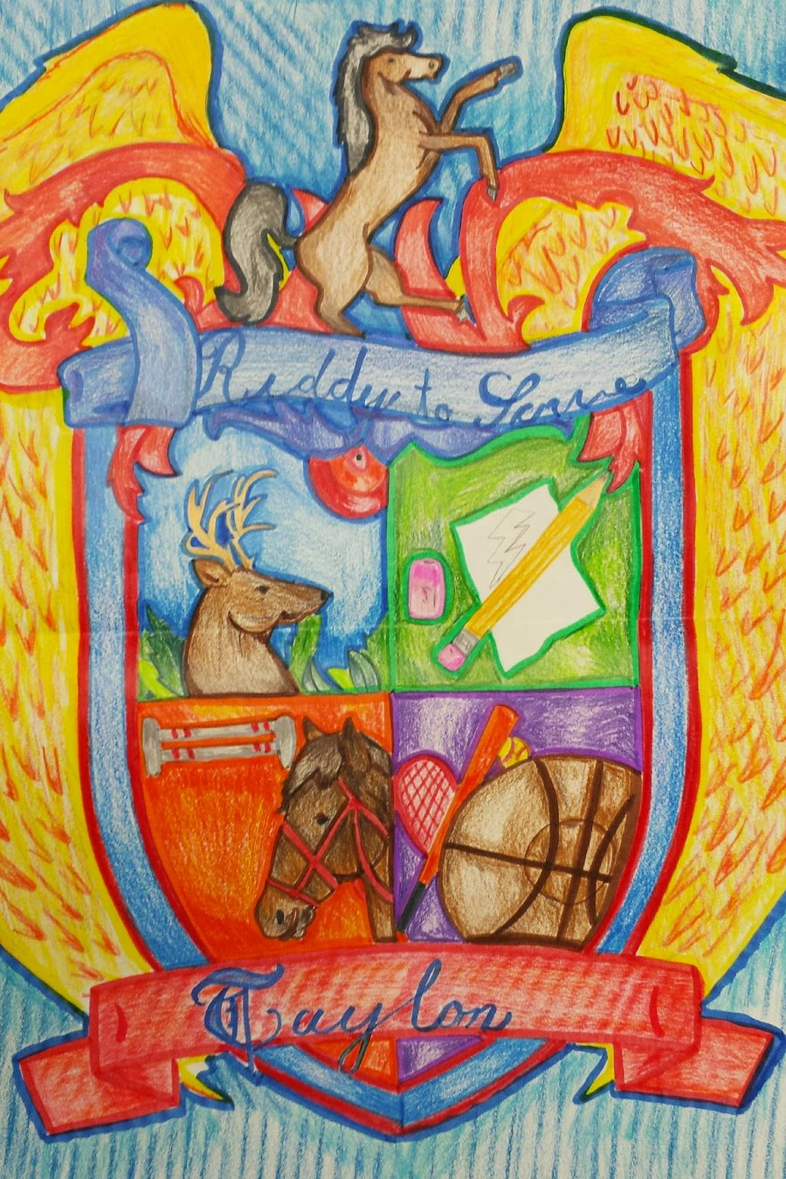
18. Crests
Create your own personal crest! What could you include to make it unique?
This Photo by Unknown Author is licensed under CC BY-NC-ND

Slide 20

19. Be the Prime Minister
If you were in charge for a day what would you do? Why? Is it practical? How could it happen?
This Photo by Unknown Author is licensed under CC BY-SA

Slide 21

20. No.1 vlogger
If you were to make a vlog about something, what would you do it on and why?
This Photo by Unknown Author is licensed under CC BY-SA

Slide 22

21. Mind map
Create a mind map about a topic you love! We can all learn from you ☺

Slide 23

22. Passing notes
Write a nice note with a compliment on it to a friend or the teacher.
This Photo by Unknown Author is licensed under CC BY-NC-ND

Slide 24

23. Chat to your partner
Find out 3 things that your partner learned today. Listen carefully so you can tell the class.

Slide 25

24. Virtual Tours
Use this link to visit places around the world: https://www.teachpal.co.uk/virtual-trips-for-children/
This Photo by Unknown Author is licensed under CC BY-SA

